Slide 1
EGU Workgroup: 2016 beta
Approach:
States submitted 2016 emissions for at least Type A sources
EPA collated and quality assured emissions and released inventory in June
Minor updates made post-June at request of a few states
States and EPA worked together to finalize EIS unit matches to CEMS data (CAMD/ORIS IDs), NEEDS IDs (to separate EGUs from non-EGUs), and ERTAC
Temporal profiles for EGUs without CEMS being developed
Status:
The NEI/NEEDS/ERTAC cross reference is now finalized for the beta
ftp://newftp.epa.gov/air/emismod/2016/beta/reports/needs_xref_2016_24Sep2018.xlsx
2016 emissions can now be extracted into sectors based on cross reference
Next Steps / Milestones:
Finalize temporal profiles over next few weeks
2016 emissions available by end of October
Develop ERTAC and IPM projections

Slide 2
EGU Workgroup: ERTAC-EGU
State review complete for:
ERTAC EGU V16.0 input files
CONUS v16.0 output files
Runs with new inputs of CONUS v16.1underway
We will complete a CONUS v16.1 run for:
Base year 2016 complete by end of October 2018
Future year 2023 & 2028 complete by mid November 2018

Slide 3
EGU Workgroup: IPM
EPA launched its updated Power Sector Modeling website in June 2018, equipped with
Power Sector Modeling Resources
IPM v6 with multiple case scenario runs and Results Viewer
We are currently working on integrating latest input data and rules to the platform
Power Sector Modeling Regulatory Applications
NEEDS will now have quarterly updates (latest: 9/17/2018)
https://www.epa.gov/airmarkets/clean-air-markets-power-sector-modeling

Slide 4
What’s in the upcoming IPM projections
Incremental updates to June 2018 projections
What’s new, what’s updated: Various financial/tax and environmental rule updates and fleet updates.
Financial assumptions based on the December Tax Reform Bill
Reflects 45Q (credit for CO2 sequestration)
Reflects final Office of Water effluent guideline (ELG) rule costs
Reflects NY minimum oil burn rule
AEO 2018 demand
AEO 2018 Variable and fixed Operational and maintenance costs for nuclear units
Updated/improved NOx rates for small units in CA (more detailed) and elsewhere
Implemented latest retirements and controls from EIA April 2018
Energy storage mandates in CA, NY, NJ, OR and MA
Hardwired energy storage projects from EIA April 2018
Updated RPS standards for CT and NJ

Slide 5
Recap of Current EPA Temporal Allocation Approach for EGUs
Units with CEMS
CEMS data are used where they are matched to NEI (NOx and SO2 directly, and heat input for rest of pollutants)
CEMS data are preprocessed to remove spikes from non-measured values
Known partial year reporters (e.g., summer only) receive special treatment allocating residual emissions to winter
Units without CEMS
Emissions allocated to months based on average pollutant and fuel-specific season-to-month factors for each IPM region derived from base year CEMS data
Heat input is used to allocate emissions from months to days in each region based on pollutant and fuel-specific factors
Cross-reference applied by SCC and FIPS
Diurnal profiles for winter and summer derived from base year CEMS data for each IPM region and fuel based on heat input
Most MWCs and co-gens were given flat emissions for each day and hour
Issues
Found that sample size based on IPM region is too small in some cases to develop reasonable temporal profiles

Slide 6
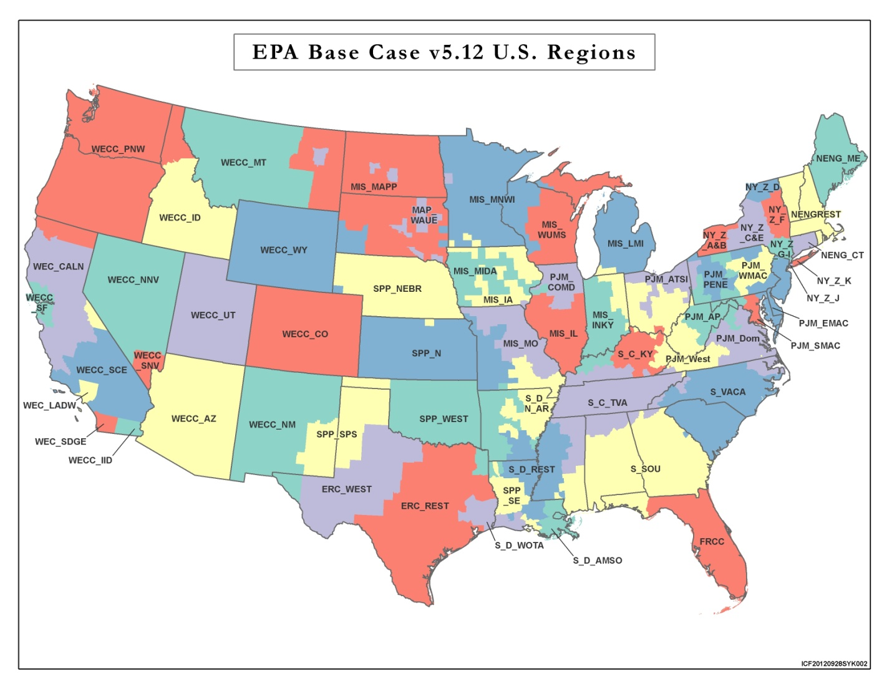
64 IPM regions for Existing Profiles

Slide 7
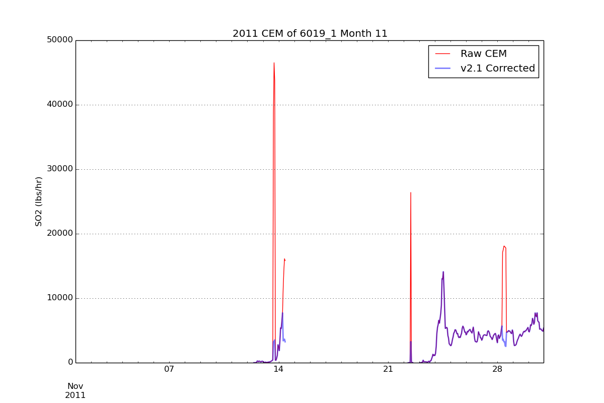
Removal of Unmeasured Spikes

Slide 8
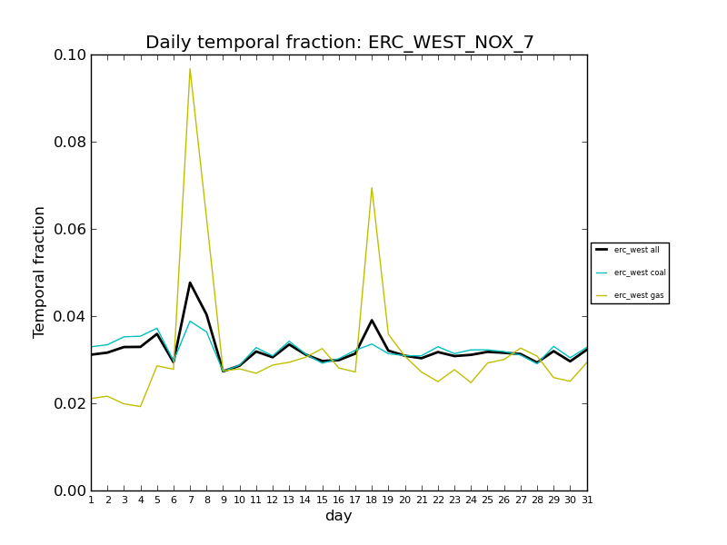
Month to Day Profile Example for Gas, Coal, Composite

Slide 9
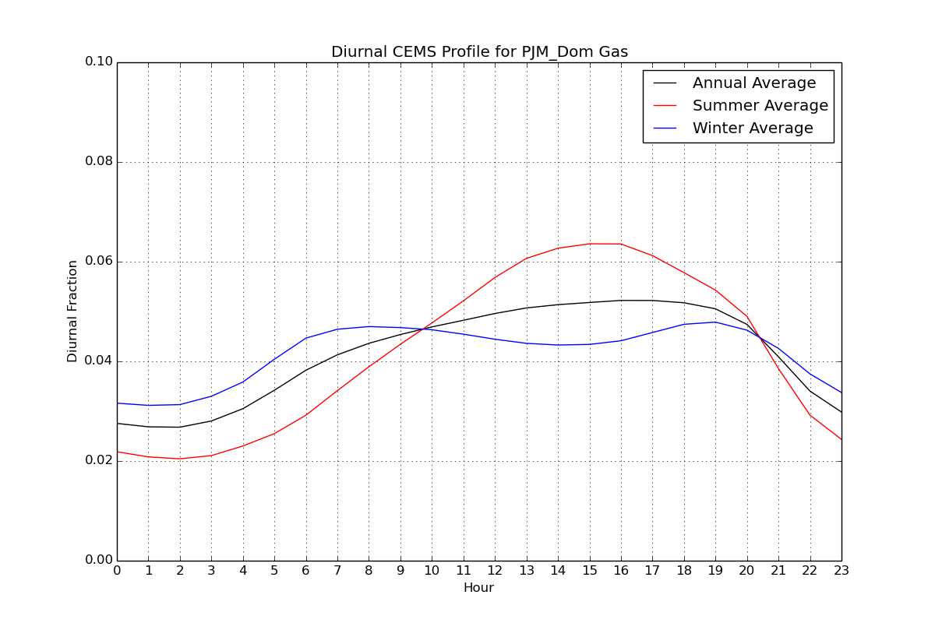
Seasonal Diurnal Profile Example

Slide 10
Decisions to be Made
Need to decide ASAP:
In the absence of measured data, should MWCs and co-gens get flat profiles?
How will we temporalize EGUs w/out CEMS (including “peaking units”)
If we derive aggregate profiles, what geographic resolution should we use? RPO, climate regions, state, a mixture?
For October meeting: how will we develop profiles for projected emissions e.g., when emissions change in future
For sources both with and without CEMS

Slide 11
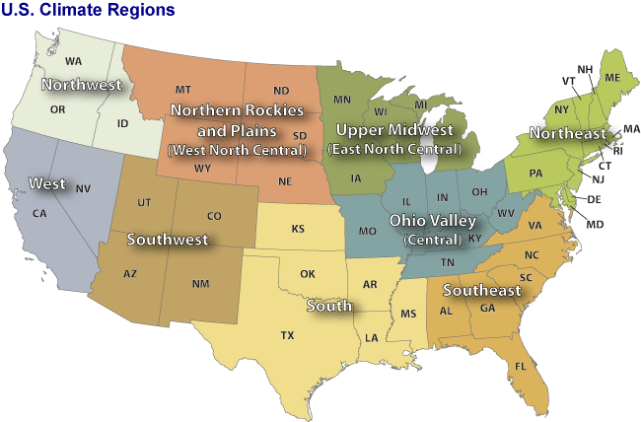
NOAA Climate regions
http://www.ncdc.noaa.gov/monitoring-references/maps/us-climate-regions.php#references
These are similar to modeling center regions, but more resolution in West

